Slide 1
Procedural Programming using Java
Department of Computer and Information Science,
School of Science, IUPUI
Dale Roberts, Lecturer
Computer Science, IUPUI
E-mail: droberts@cs.iupui.edu

Slide 2


Introduction
Divide and conquer technique
  Construct a large program from smaller pieces (or modules)
  Can be accomplished using methods
static methods can be called without the need for an object of the class
Random number generation
Constants

Slide 3
Methods are Modules
Methods
  Called functions or procedures in some other languages
  Modularize programs by separating its tasks into self-contained units
  Enable a divide-and-conquer approach
  Are reusable in later programs
  Prevent repeating code

Slide 4

Methods That Come With Java
Java Application Programming Interface (API)
  Also known as the Java Class Library
  Contains predefined methods and classes
    Related classes are organized into packages
    Includes methods for mathematics, string/character manipulations, input/output, databases, networking, file processing, error checking and more

Slide 5
Accessing Java’s Documentation
Familiarize yourself with the rich collection of classes and methods provided by the Java API (java.sun.com/javase/6/docs/api/).
Section 6.8 presents an overview of several common packages.
In Appendix G explains how to navigate the Java API documentation.

Slide 6
Invoking Methods
static method (or class method)
  Applies to the class as a whole instead of a specific object of the class
  Call a static method by using the method call:
  ClassName.methodName( arguments )
  All methods of the Math class are static
    example: Math.sqrt( 900.0 )

Slide 7
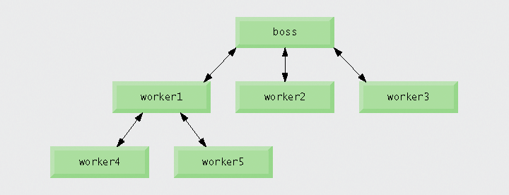
Stepwise Decomposition

Slide 8
java.lang Package
Class Math is part of the java.lang package, which is implicitly imported by the compiler, so it is not necessary to import class Math to use its methods.

Slide 9
Defining Constants
Constants
  Keyword final
  Cannot be changed after initialization
static fields (or class variables)
  Are fields where one copy of the variable is shared among all objects of the class
Math.PI and Math.E are final static fields of the Math class

Slide 10
Main Method
Method main
  main is declared static so it can be invoked without creating an object of the class containing main
  Any class can contain a main method
    The JVM invokes the main method belonging to the class specified by the first command-line argument to the java command

Slide 11
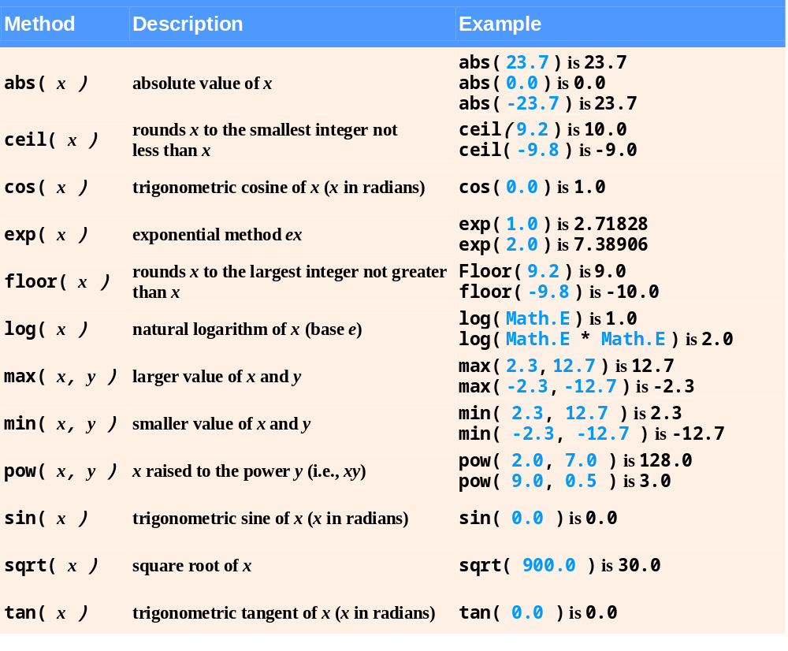
Math Methods

Slide 12
Declaring Methods with Multiple Parameters
Multiple parameters can be declared by specifying a comma-separated list.
  Arguments passed in a method call must be consistent with the number, types and order of the parameters
    Sometimes called formal parameters

Slide 13
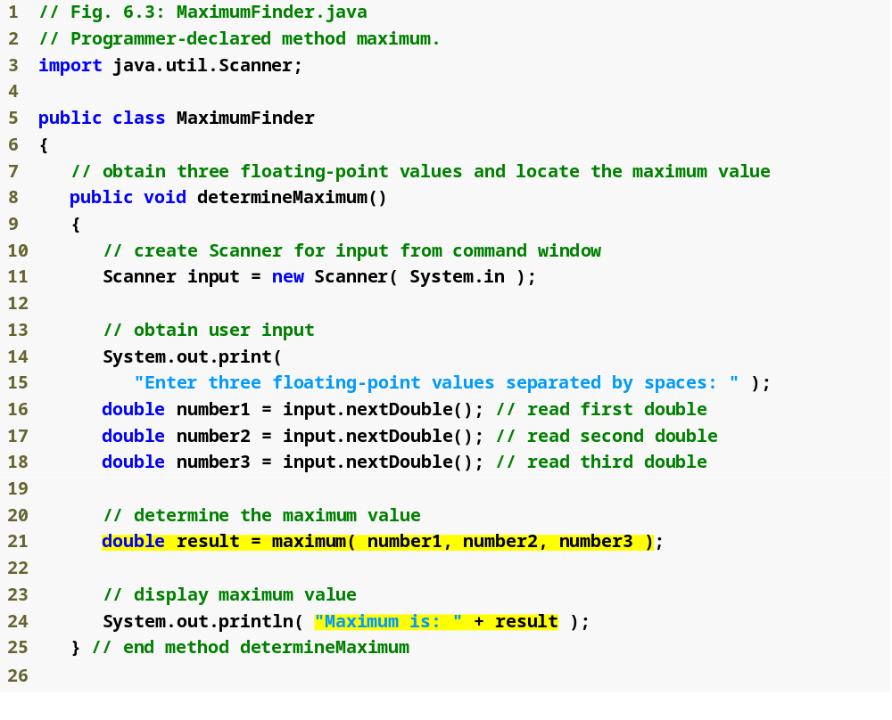
Outline
MaximumFinder.java
(1 of 2)
Call method maximum
Display maximum value

Slide 14
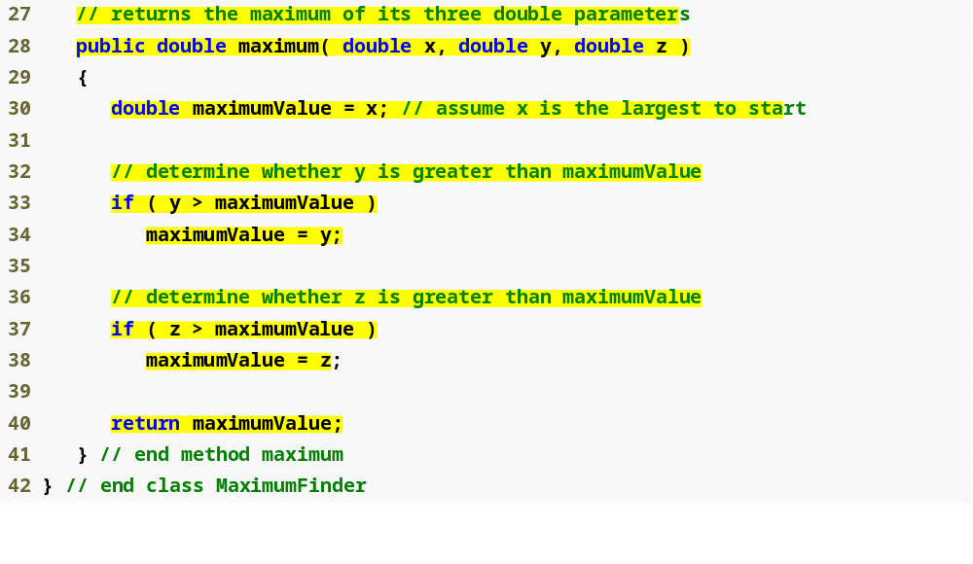
Outline
Declare the maximum method
MaximumFinder.java
(2 of 2)
Compare y and maximumValue
Compare z and maximumValue
Return the maximum value

Slide 15
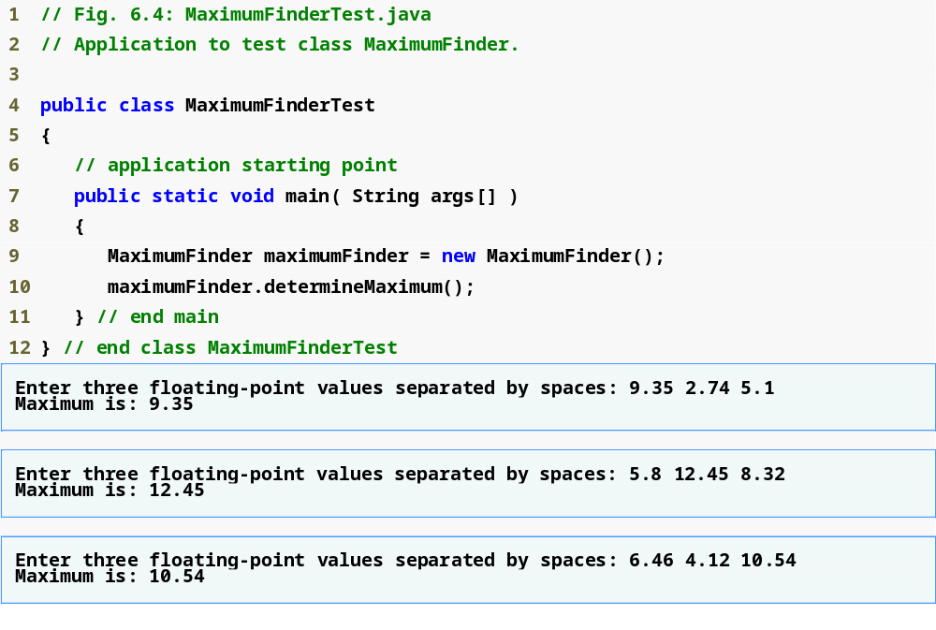
Outline
Create a MaximumFinder object
MaximumFinderTest
.java
Call the determineMaximum method

Slide 16
Built-in Methods with Parameters
Reusing method Math.max
  The expression Math.max( x, Math.max( y, z ) ) determines the maximum of y and z, and then determines the maximum of x and that value
String concatenation
  Using the + operator with two Strings concatenates them into a new String
  Using the + operator with a String and a value of another data type concatenates the String with a String representation of the other value
    When the other value is an object, its toString method is called to generate its String representation

Slide 17
Invoking Methods
Three ways to call a method:
  Use a method name by itself to call another method of the same class
  Use a variable containing a reference to an object, followed by a dot (.) and the method name to call a method of the referenced object
  Use the class name and a dot (.) to call a static method of a class
static methods cannot call non-static methods of the same class directly

Slide 18
How Method Calls Are Implemented
Stacks
  Last-in, first-out (LIFO) data structures
    Items are pushed (inserted) onto the top
    Items are popped (removed) from the top
Program execution stack
  Also known as the method call stack
  Return addresses of calling methods are pushed onto this stack when they call other methods and popped off when control returns to them

Slide 19

How Method Calls Are Implemented
  A method’s local variables are stored in a portion of this stack known as the method’s activation record or stack frame
    When the last variable referencing a certain object is popped off this stack, that object is no longer accessible by the program
      Will eventually be deleted from memory during “garbage collection”
    Stack overflow occurs when the stack cannot allocate enough space for a method’s activation record

Slide 20
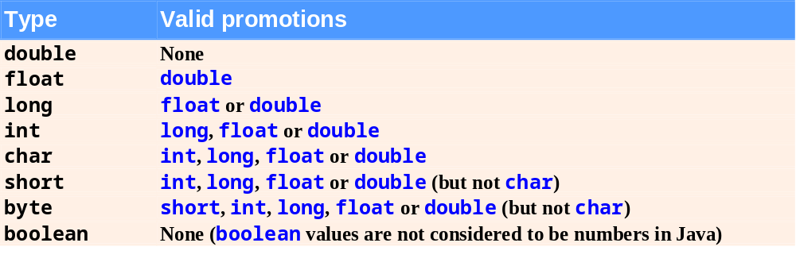
Argument Promotion (weak typing)

Slide 21
Java Packages
Including the declaration
import java.util.Scanner;
allows the programmer to use Scanner instead of java.util.Scanner
Java API documentation
  java.sun.com/javase/6/docs/api/
Overview of packages in Java SE 6
  java.sun.com/javase/6/docs/api/overview-summary.html

Slide 22
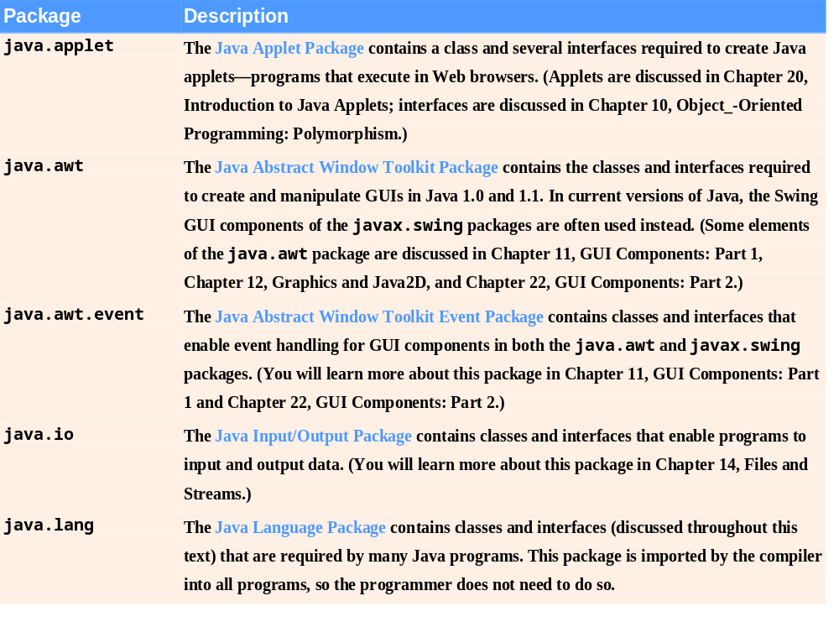
Fig. 6.6 | Java API packages (a subset). (Part 1 of 2)

Slide 23
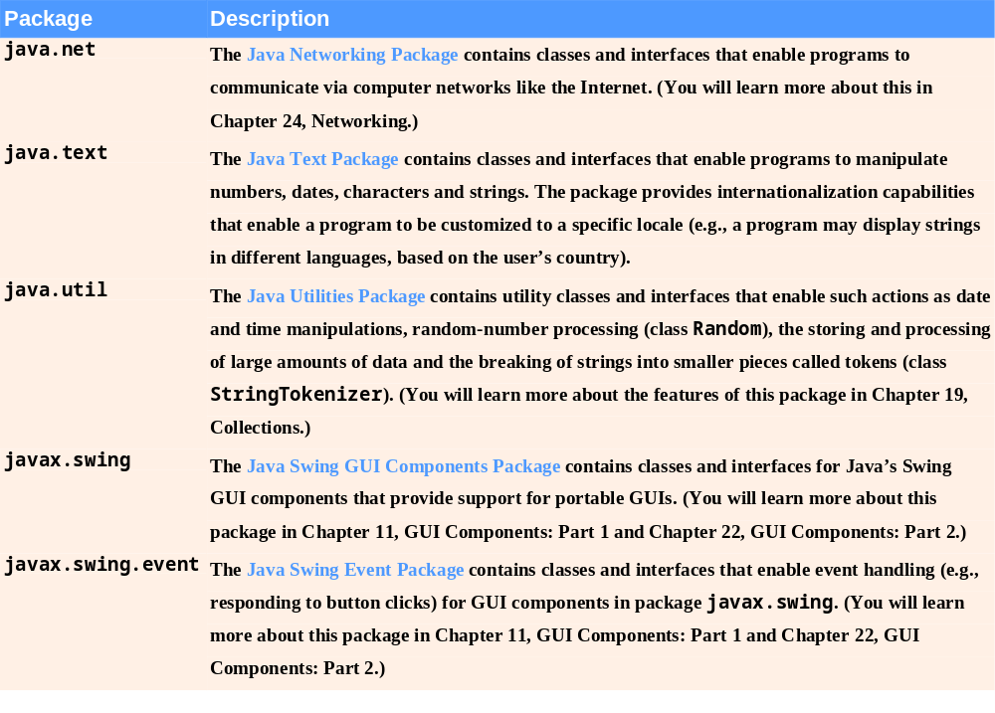
Fig. 6.6 | Java API packages (a subset). (Part 2 of 2)

Slide 24
Java Packages
Including the declaration
import java.util.Scanner;
allows the programmer to use Scanner instead of java.util.Scanner
Java API documentation
  java.sun.com/javase/6/docs/api/
Overview of packages in Java SE 6
  java.sun.com/javase/6/docs/api/overview-summary.html

Slide 25
Scope Rules
Basic scope rules
  Scope of a parameter declaration is the body of the method in which appears
  Scope of a local-variable declaration is from the point of declaration to the end of that block
  Scope of a local-variable declaration in the initialization section of a for header is the rest of the for header and the body of the for statement
  Scope of a method or field of a class is the entire body of the class

Slide 26
Shadowing
Shadowing
  A field is shadowed (or hidden) if a local variable or parameter has the same name as the field
    This lasts until the local variable or parameter goes out of scope

Slide 27
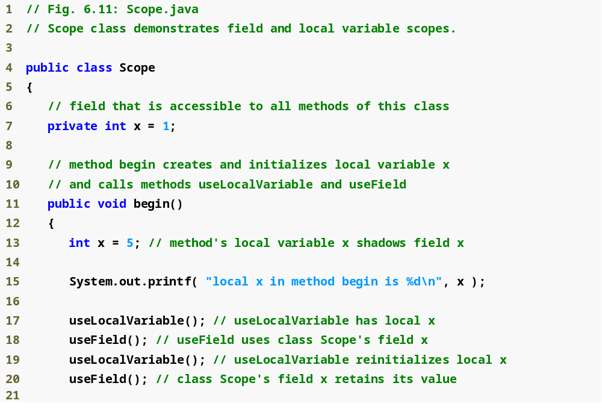
Outline
Scope.java
(1 of 2)
Shadows field x
Display value of local variable x

Slide 28
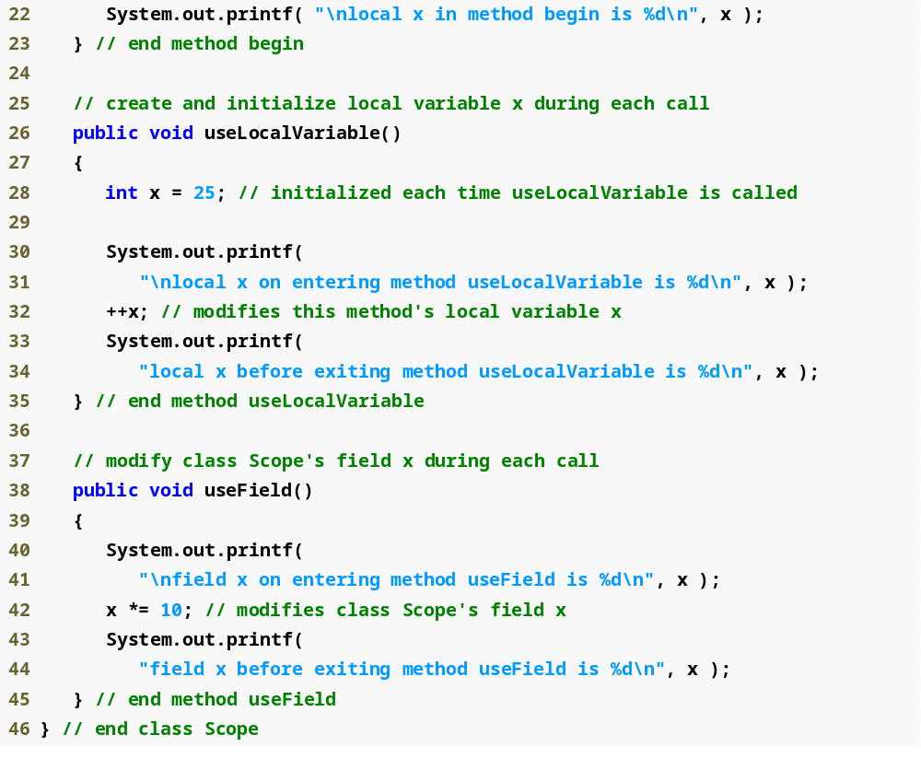
Outline
Shadows field x
Scope.java
(2 of 2)
Display value of local variable x
Display value of field x

Slide 29
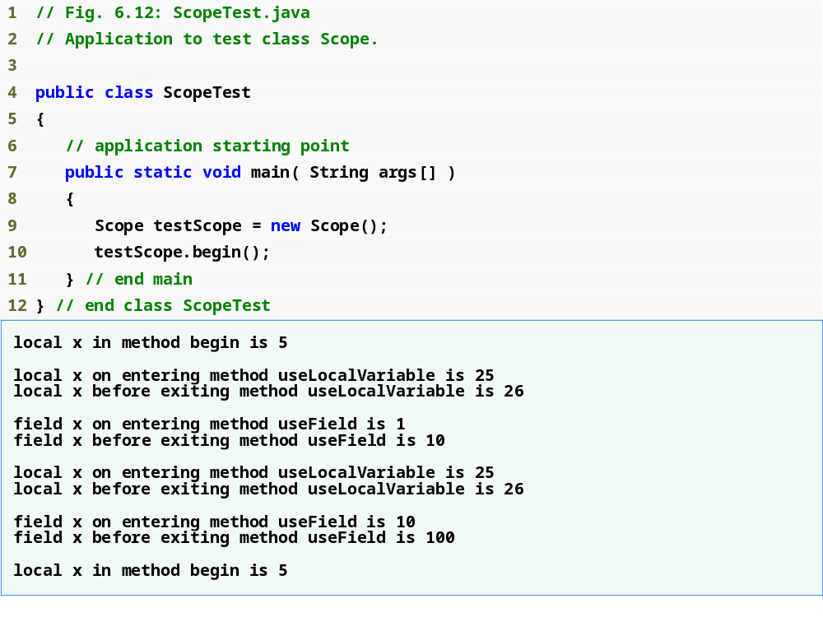
Outline
ScopeTest.java

Slide 30
6.12 Method Overloading
Method overloading
  Multiple methods with the same name, but different types, number or order of parameters in their parameter lists
  Compiler decides which method is being called by matching the method call’s argument list to one of the overloaded methods’ parameter lists
    A method’s name and number, type and order of its parameters form its signature
  Differences in return type are irrelevant in method overloading
    Overloaded methods can have different return types
    Methods with different return types but the same signature cause a compilation error

Slide 31
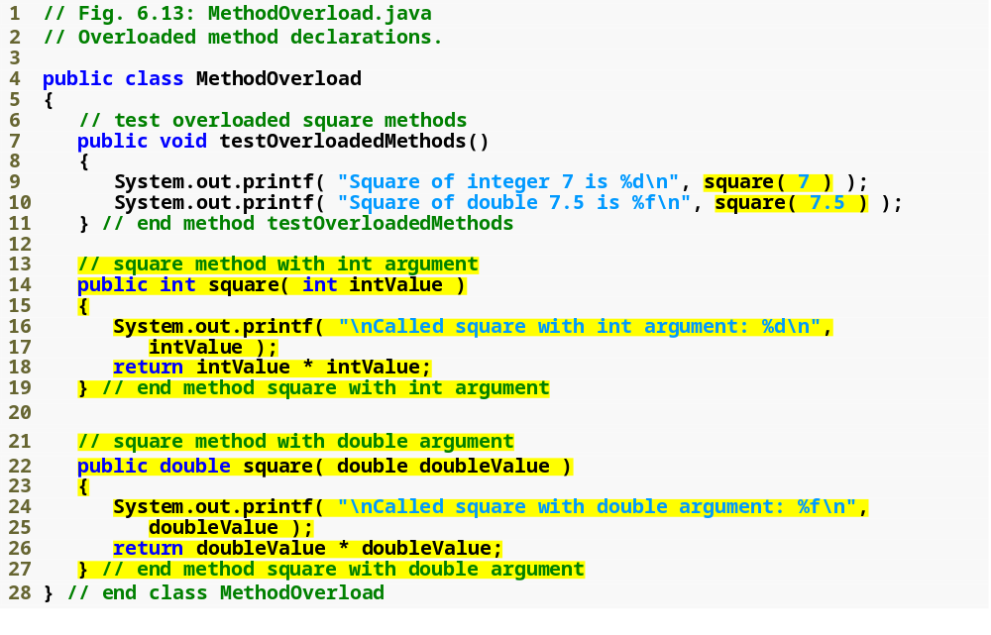
Outline
Correctly calls the “square of int” method
MethodOverload.java
Correctly calls the “square of double” method
Declaring the “square of int” method
Declaring the “square of double” method

Slide 32
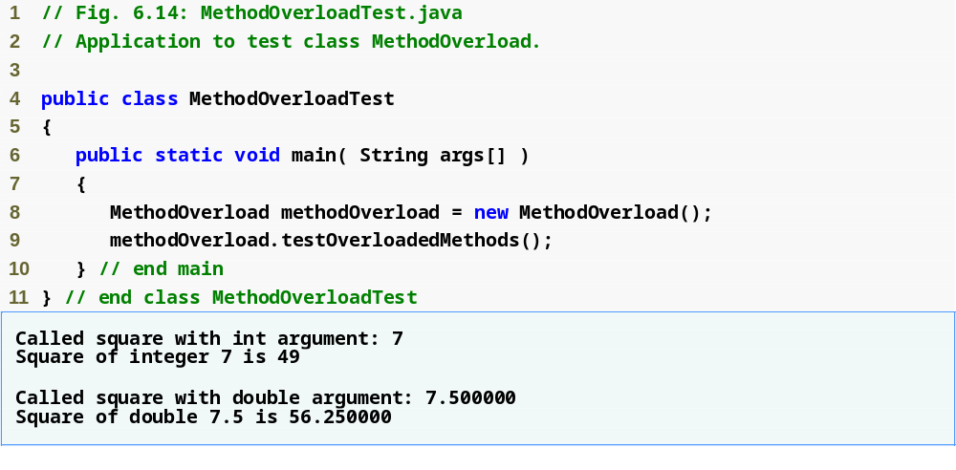
Outline
MethodOverloadTest.java

Slide 33
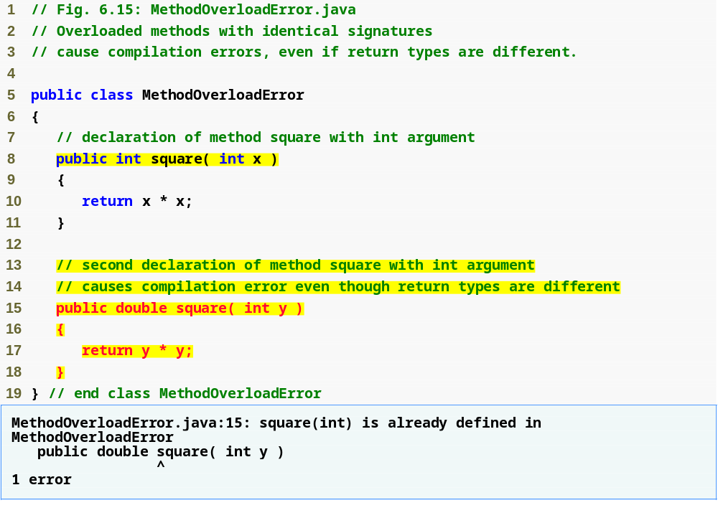
Outline
MethodOverload
Error.java
Same method signature
Compilation error

Slide 34
Acknowledgements
Deitel, Java How to Program

